Slide 1

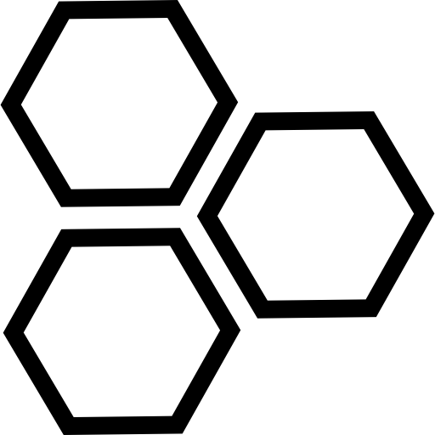

Minesweepers Competition 2026
13th Edition
TEAM NAME
Category

Slide 2

THE CHALLENGE
The mission and our answer
The arena demands
Our design response
Rough 20 × 20 m arena: sand, grass, inclines, ditches
Tracked chassis with 15 cm wide tracks
Buried 10 cm cubes (≤ 10 cm deep) and 5 cm surface cubes
Metal detector + camera with on-laptop vision
Light and siren on every detection
Light + siren fire on every metal hit
Automatic mine map on a 19 × 19 grid (A–S, 1–19)
Kalman localization + automatic mapping
Collect the surface mines
Autonomous pickup sequence: arm + electromagnet
No Wi-Fi and no power provided at the arena
Onboard access point, 2 × 10 Ah LiPo
Minesweepers 13th Edition · Watad Ejust
2
Notes:
Source: Minesweepers 2026 rulebook, Academia category. Each design choice in this talk traces back to one of these requirements.

Slide 3
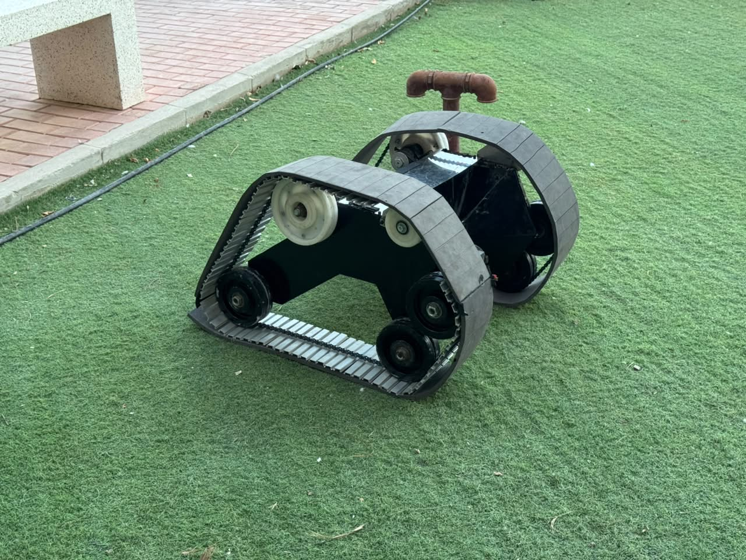
OVERVIEW
Robot at a glance
80 × 75 × 46 cm
2 × 250 W
Length × width × height
24 V geared track motors
Pi 4 + STM32
2 × 10 Ah
High-level + real-time control
LiPo battery packs
Own Wi-Fi
ROS 2
Onboard access point
Robot and base station
Minesweepers 13th Edition · Watad Ejust
3
Notes:
Teleoperated tracked UGV. Final mass is still being measured; the rule limit is 40 kg.

Slide 4
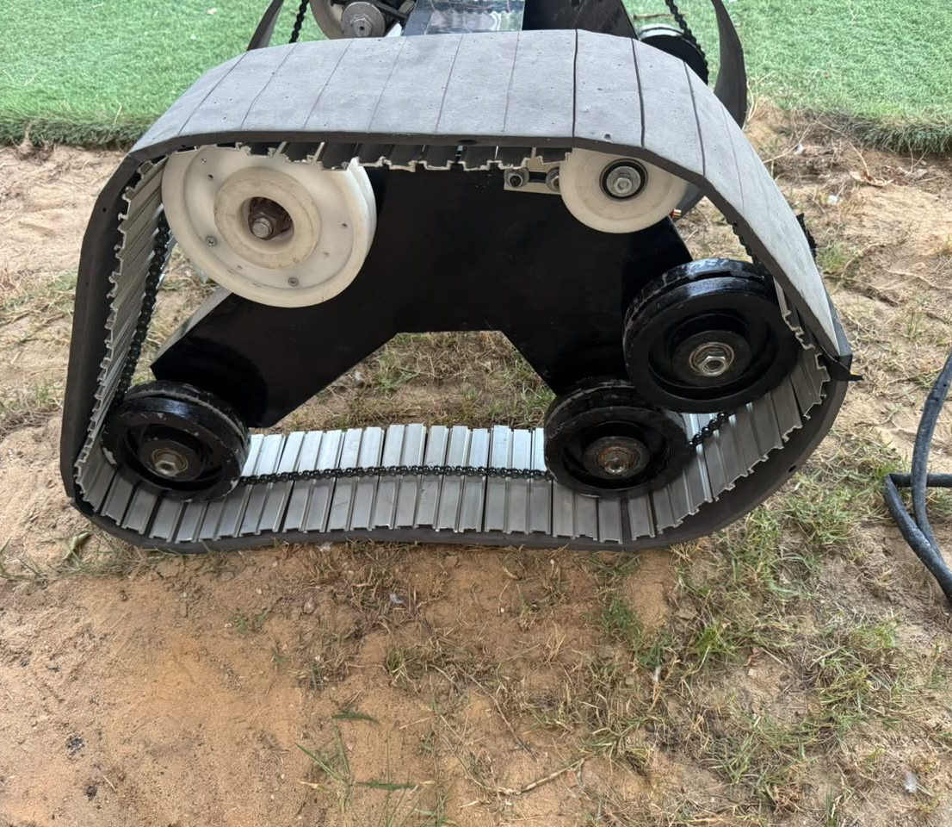
01
Mechanical Systems & Robot Structure
Body structure
Why tracks over wheels on sand
Track construction and drive train
Arm and autonomous pickup
Built for sand and heat
Minesweepers 13th Edition · Watad Ejust
4

Slide 5
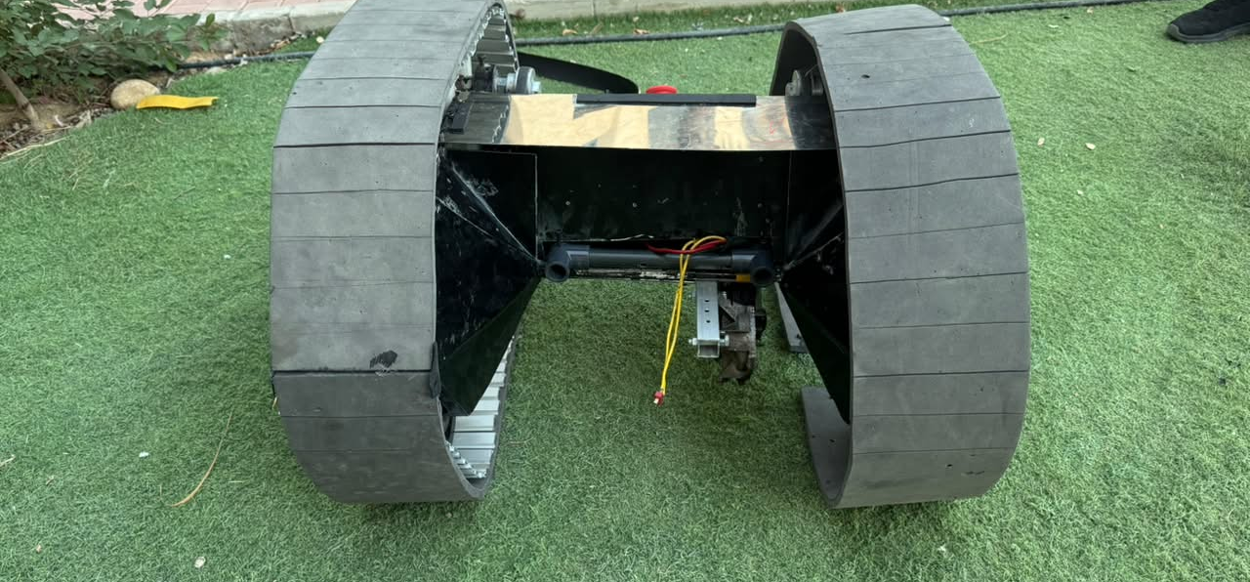
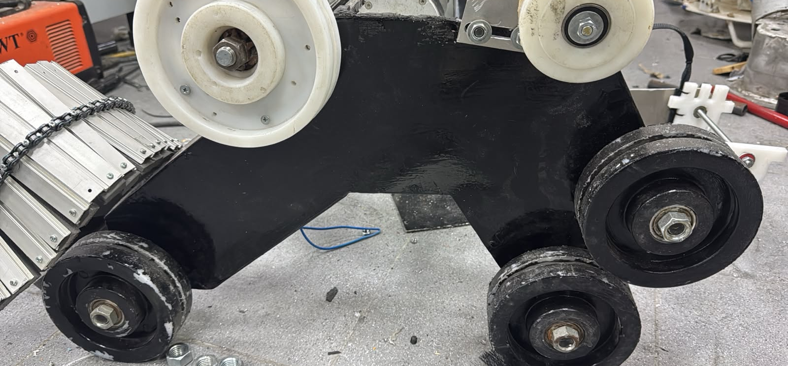
MECHANICAL
Body structure
1
Two track pods
2
Central spine
3
Low and wide
Each pod carries its own motor, chain drive, idlers and road wheels.
Bridges the pods and carries the electronics, control panel and arm.
80 × 75 × 46 cm footprint keeps the centre of gravity low between the tracks.
Minesweepers 13th Edition · Watad Ejust
5
Notes:
Left: rear view with both track loops and the spine. Right: bare chassis showing idlers and road wheels.

Slide 6
MECHANICAL
Why tracks over wheels on sand
≈ 9× lower ground pressure
Floats on loose sand: the long footprint spreads the load instead of digging in.
Traction: every slat is a grouser biting into sand and grass.
Bridges ditches and stones that would trap a small wheel.
Trade-off: skid-steer turns need more torque, so we use 250 W geared motors.
Contact estimates: 2 tracks × 0.60 m × 0.15 m vs 4 wheels × 10 × 5 cm patch.
Minesweepers 13th Edition · Watad Ejust
6
Notes:
Ground pressure p = m·g / contact area. The 0.6 m contact length per track is an estimate from the 195 cm track loop; replace it with the measured value. The comparison holds at any final mass.

Slide 7
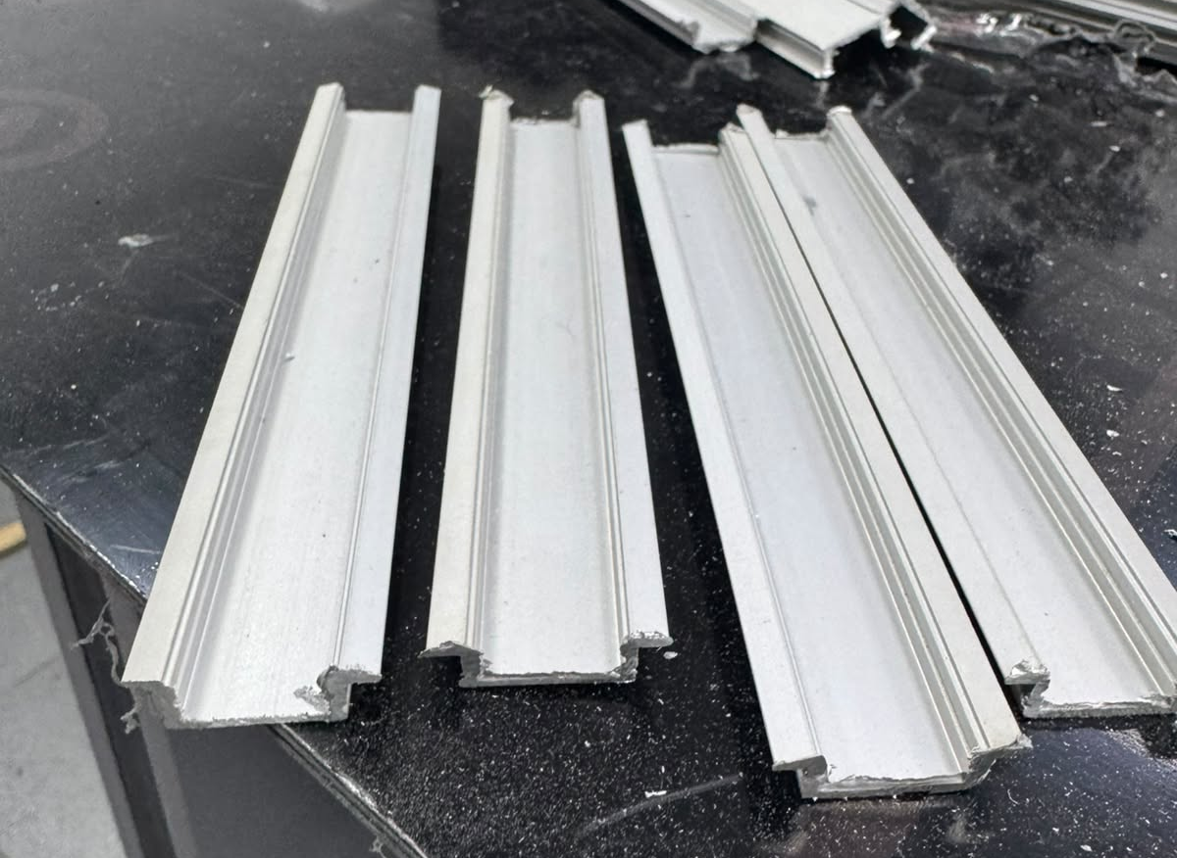
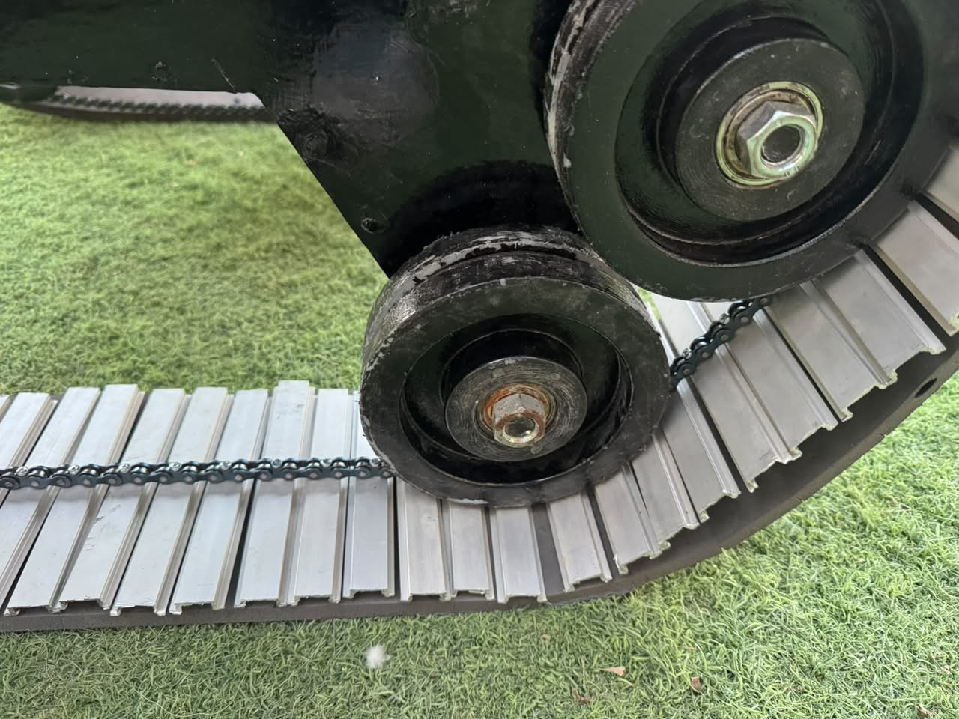
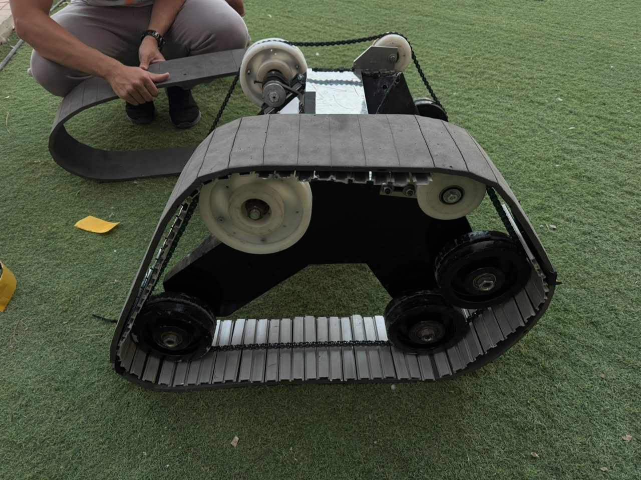
MECHANICAL
Track construction
1
2
3
Aluminium slats
Chain drive
Rubber grip layer
Extruded profile with a stepped edge that acts as a grouser.
The chain carries motor torque from the sprocket to every slat.
Rubber sheet with cuts so it fits around the slats and grips the sand.
Track loop 195 cm · width 15 cm · white idlers on top, road wheels below carry the load
Minesweepers 13th Edition · Watad Ejust
7
Notes:
Two layers with two jobs: the chain transmits torque, the rubber sheet adds grip. Cuts in the sheet let it sit flush around each slat.

Slide 8
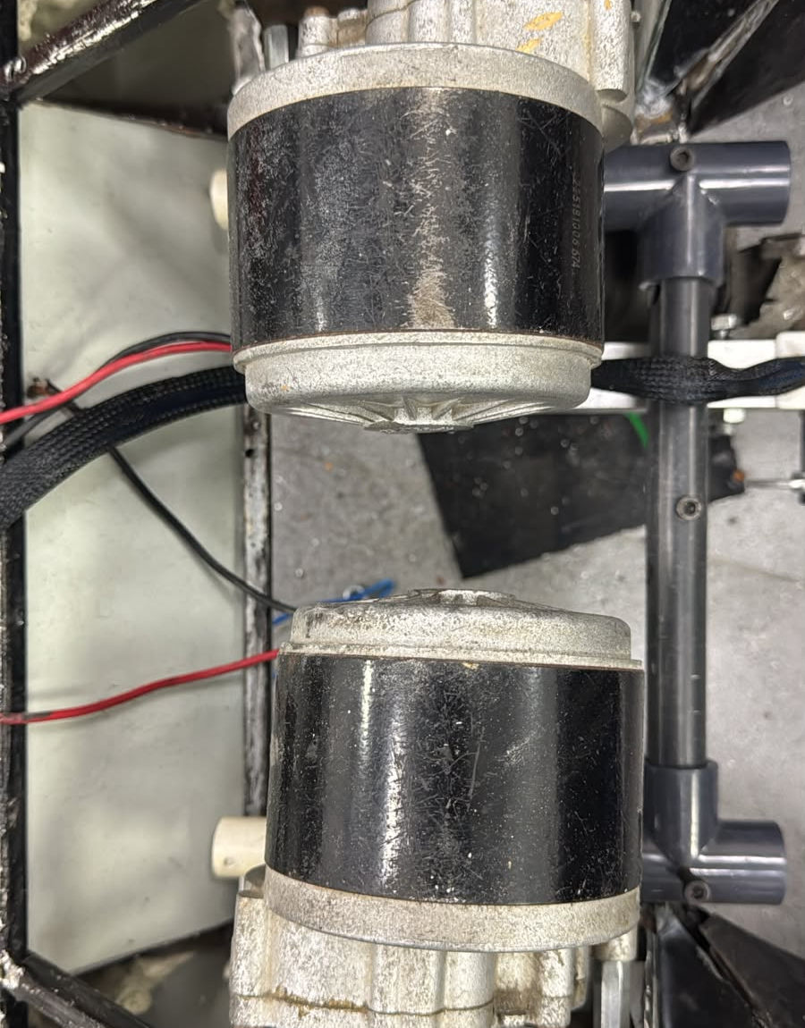
MECHANICAL
Drive train
Motor | MY1016Z brushed DC gear motor, 2 units
Origin | Electric wheelchair drive, sourced locally
Supply | 24 V DC
Rated power | 250 W each, 500 W total
Gearbox | Integrated reduction, high output torque
Current | ≈ 10.4 A each at rated output (250 W ÷ 24 V)
Transmission | Chain from gearbox shaft to track sprocket
Skid steering
Same speed on both tracks drives straight; a speed difference turns the robot, down to turning in place. The STM32 mixes the forward and turn commands.
Minesweepers 13th Edition · Watad Ejust
8
Notes:
Specs from the MY1016Z listing (24 V, 250 W). Repurposed wheelchair motors gave high torque on a student budget.

Slide 9
MECHANICAL · DISPOSAL
Arm design: one joint, free-hanging end
1
One degree of freedom
upright
A single rotary joint driven by the wiper motor: one motor, one limit switch, no arm kinematics to solve.
2
Free-weight end
Single joint
driven by the wiper motor
The electromagnet hangs from a free pivot, so gravity keeps it facing the ground at any arm angle, even on a slope.
Free-hanging end
gravity keeps the magnet down
g
Chassis
3
Simple, effective control
Magnet
+ mine
Only two positions, lowered and upright, with the upright switch as the reference: easy for the STM32 to control reliably.
Minesweepers 13th Edition · Watad Ejust
9
Notes:
Design choice: fewer actuators and sensors means fewer failure points in sand and heat, and a control problem small enough for the STM32 to run autonomously.

Slide 10
MECHANICAL · DISPOSAL
Autonomous pickup sequence
1
Trigger
2
Lower
3
Grab
4
Stow
Operator presses Pick up (J) once. The GUI sends it only if the arm reads upright.
The wiper motor swings the arm down over the surface mine.
The electromagnet is energised and the arm lifts the steel cube.
The magnet releases the mine into the container; the arm returns upright.
Arm motor: WD1160-series wiper motor
12 V DC · aluminium die-cast gearbox · two speeds
Rated 21.5–28 rpm, 5.2–13.2 N·m (peak up to 15 N·m) depending on variant and speed
Runs autonomously
Once triggered, the STM32 runs every step with no operator input. An upright limit switch blocks a new pickup until the arm is back.
Minesweepers 13th Edition · Watad Ejust
10
Notes:
Datasheet: M&C WD1160 / WD1160-B wiper motor, performance at rated 12 V.

Slide 11
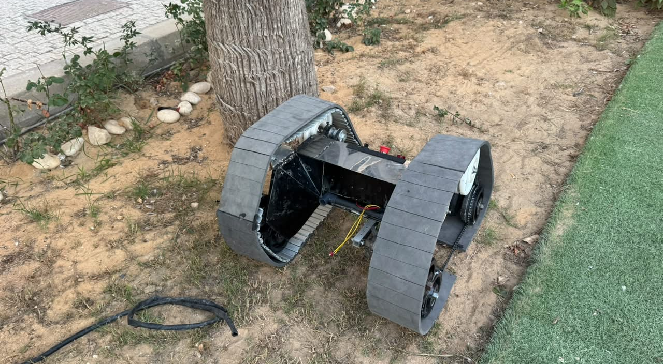
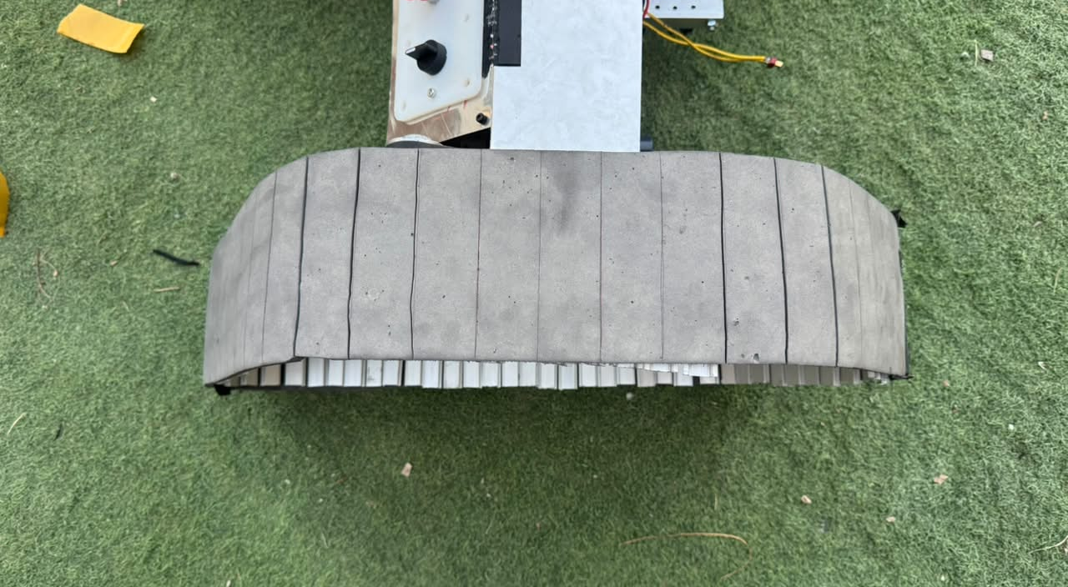
MECHANICAL · ROUGH ENVIRONMENT
Built for sand and heat
Sand and rough terrain
Heat
Low ground pressure keeps the robot on top of loose sand
Slat grousers + rubber grip layer for traction on sand and grass
Long track footprint bridges ditches and stones
Tested outdoors on sand and grass
Electronics sit inside the chassis, shaded from direct sun
Drive motors cruise well below their 250 W rating
LiPo temperature checked between runs; spare pack ready
Minesweepers 13th Edition · Watad Ejust
11
Notes:
Confirm the heat measures with the team before presenting; the arena is outdoors in Egypt.

Slide 12
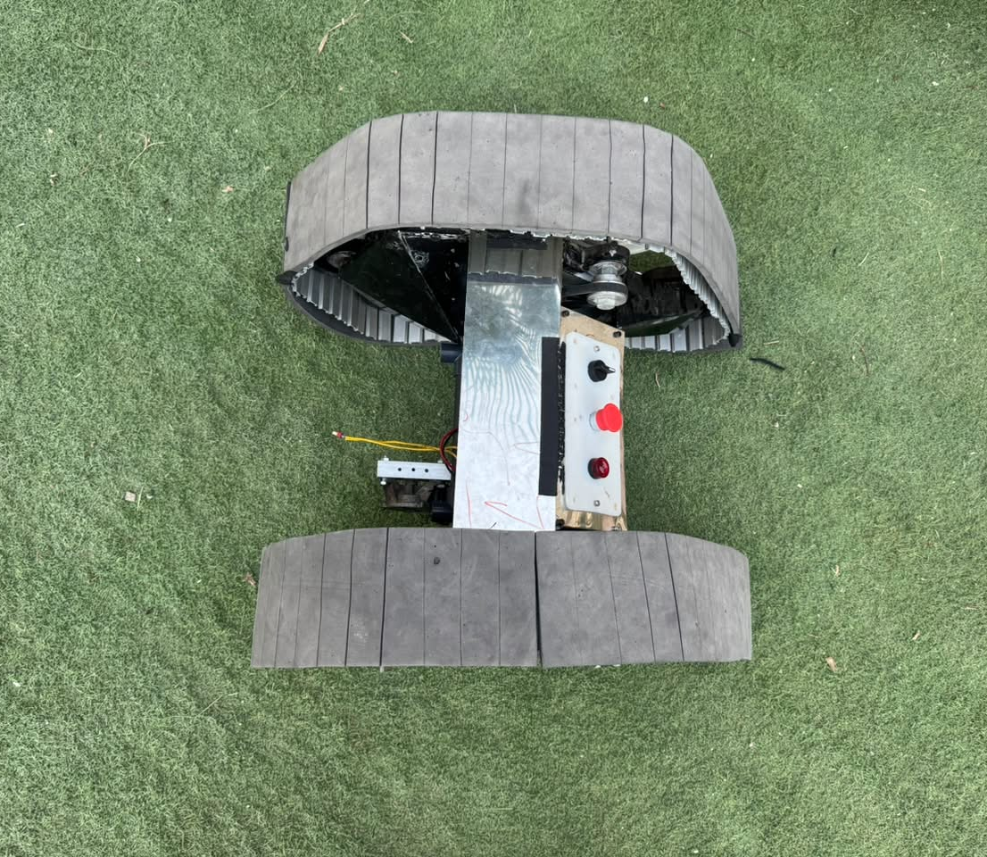
02
Electronic Components & Control System
Sensors and microcontrollers
Why an STM32 for real-time control
Power architecture and budget
On-robot and robot-to-station links
Layered safety stops
Minesweepers 13th Edition · Watad Ejust
12

Slide 13
ELECTRONICS
Sensors and controllers
Component | Role | Interface
Raspberry Pi 4 | ROS 2, localization, video streaming | Main computer
STM32 Black Pill | Motor PWM, encoders, ADC, arm, magnet, watchdog | UART to Pi
Wheel encoders | Track odometry | STM32 timers
MPU-9250 IMU | 9-axis: accelerometer, gyro, magnetometer | I2C to Pi
Metal detector | Buried and surface mines | Analog to STM32 ADC
USB camera | Surface-mine vision and operator view | USB to Pi
Motor drivers | 2 × 250 W track motors + arm motor | PWM from STM32
Electromagnet + limit switch | Mine pickup, arm-upright interlock | STM32 I/O
Light + siren | Signal every detection | Digital output
Wi-Fi access point | Robot's own network to the base station | Network
Minesweepers 13th Edition · Watad Ejust
13
Notes:
Real-time I/O lives on the STM32; anything that needs Linux, ROS or a camera lives on the Pi.

Slide 14
ELECTRONICS
Why an STM32 for real-time control
1
Hardware encoder timers
2
Deterministic timing
Quadrature counting in hardware: no lost counts at full track speed.
A bare-metal control loop with fixed timing for PWM, sampling and the watchdog.
3
12-bit ADC
4
Dedicated to control
Samples the metal-detector signal for clean threshold detection.
Networking lives on the Pi and the onboard AP; the MCU only runs real-time I/O.
Minesweepers 13th Edition · Watad Ejust
14
Notes:
STM32 Black Pill. It talks to the Pi over UART with COBS framing and enforces the 250 ms motor watchdog.

Slide 15
ELECTRONICS
Power architecture
Motor drivers
2 × MY1016Z, 250 W each
24 → 12 V converter
Wiper arm motor · electromagnet · light + siren
2 × 10 Ah
LiPo packs
Main switch
+ E-stop buttons
24 V
bus
24 → 5 V converter
Raspberry Pi 4 → camera, IMU, STM32
E-stop first: every load sits downstream of the hardware stop.
High-current drive path is kept separate from the regulated logic supplies.
Access point supply
Robot Wi-Fi network
Minesweepers 13th Edition · Watad Ejust
15
Notes:
Check the pack wiring (series vs parallel) and converter ratings with the electronics lead before presenting.

Slide 16
ELECTRONICS · COMMUNICATION
Pi to STM32 link
Raspberry Pi 4
ROS 2 hardware-interface node
Down: drive (forward, turn) · pickup
STM32 Black Pill
Real-time firmware
Up: encoder counts · metal level · arm upright
UART frame
COBS byte
type
payload (packed struct)
checksum
0x00
COBS framing
Checksum
250 ms watchdog
Zero bytes appear only as the delimiter, so the receiver always resynchronises on the next frame.
A corrupted frame is dropped, never acted on.
No valid command for 250 ms → the STM32 sets motor PWM to zero.
Minesweepers 13th Edition · Watad Ejust
16
Notes:
Structs are packed so the 32-bit MCU and the 64-bit Pi agree on the byte layout.

Slide 17
ELECTRONICS · COMMUNICATION
Robot to control station: our own network
Robot
Base station (outside the fence)
ROS 2 DDS
drive at 20 Hz · odometry · metal · arm
Onboard Wi-Fi access point
Laptop joins the robot's AP
Raspberry Pi 4
ROS 2 nodes · RTSP server
ROS 2 bridge
Docker
RTSP video, H.264
kept out of DDS to save bandwidth
STM32 + sensors
GUI + vision
Why on the robot? The arena provides no Wi-Fi, so the link is the same in the lab and at the competition.
Minesweepers 13th Edition · Watad Ejust
17
Notes:
The 20 × 20 m arena diagonal is about 28 m plus the distance to the base station; the AP rides on the robot so range is set by our own hardware.

Slide 18
ELECTRONICS
Power budget
≈ 600 W
≈ 230 W
Peak, all loads at rating
Match average (drive at ~40 %)
≈ 75 Wh
≈ 3 runs
Energy for one 20 min run
From ≈ 222 Wh on board**
**Assumes the two 10 Ah packs form one 22.2 V (6S) bus. Peak ≈ 27 A, well inside the packs' discharge rating.
Motor values from datasheets (wiper: 12 V × 5.6 A). *Estimates, to be measured.
Minesweepers 13th Edition · Watad Ejust
18
Notes:
Replace the starred estimates with measured currents. Battery energy depends on the pack configuration.

Slide 19
CONTROL SYSTEM
Stopping is layered
Laptop → robot
1
2
3
4
5
6
GUI focus lost
GUI refresh
ROS bridge
Raspberry Pi
STM32 watchdog
Hardware E-stop
Drive zeroed, speed lock cleared
No UI update for 200 ms → zero
Drops commands > 200 ms old, publishes one zero
Own motion timeout
250 ms without valid frame → PWM 0
Cuts power to the loads
Every stage fails safe on its own. A lost link, hung GUI or crashed process stops the robot, and reconnecting never resumes motion: the operator must press a key again.
Minesweepers 13th Edition · Watad Ejust
19
Notes:
These are per-stage timeouts, each independent of the others.

Slide 20
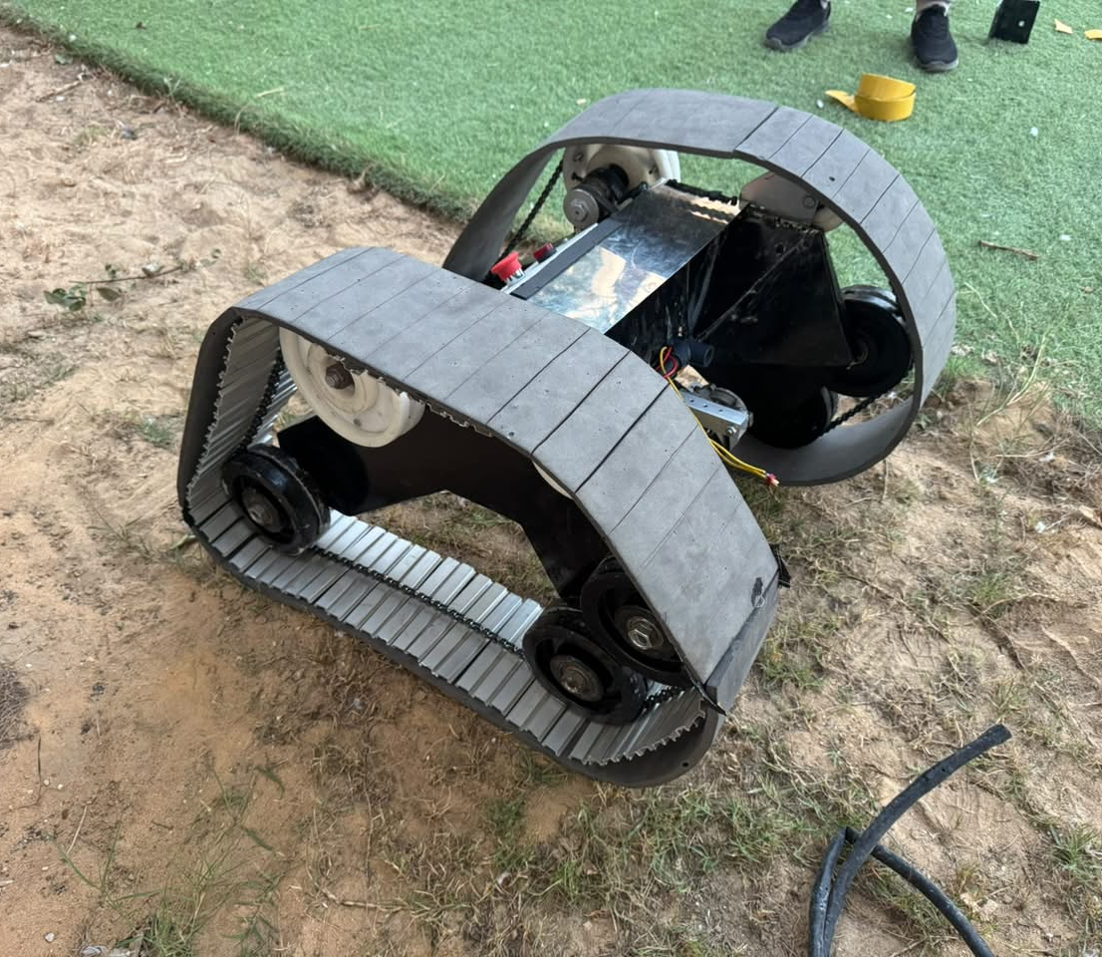
03
Software Stack
Architecture: STM32, Pi and laptop
Mapping and localization
Mine detection and classification
Control station GUI
Navigation plan and reliability
Minesweepers 13th Edition · Watad Ejust
20

Slide 21
SOFTWARE
Architecture: three tiers, one contract
STM32 firmware
Raspberry Pi 4 · ROS 2 in Docker
Base-station laptop
Real-time loops
PWM · encoders · ADC · arm sequence · watchdog
UART
Hardware interface
DDS
Wi-Fi
ROS 2 bridge (Docker)
ZeroMQ IPC
One packed, versioned C++ header shared by GUI, bridge and vision
Separate processes
An inference stall or bridge crash can't freeze the GUI
IMU filter (Madgwick)
Control panel GUI
Kalman filter
RTSP video server
RTSP
Vision: ONNX Runtime
Minesweepers 13th Edition · Watad Ejust
21
Notes:
Kalman output is /odometry/filtered. The GUI owns mine mapping; the bridge only translates.

Slide 22
SOFTWARE
Mapping and localization
A
D
G
J
M
P
S
1
Localize
19
Kalman filter fuses track odometry (STM32 encoders) with the MPU-9250 heading. No GPS.
16
2
Re-anchor
13
At a known corner the operator resets x, y and snaps the heading to the nearest 90°.
10
3
Place the mine
7
Robot pose + detector offset (dx, dy), rotated by heading θ:
xₘ = x + dx·cos θ − dy·sin θ
yₘ = y + dx·sin θ + dy·cos θ
4
1
R
4
Merge and persist
Buried
Surface
Hits within a merge radius are one mine; records survive a restart. The map is generated automatically.
Minesweepers 13th Edition · Watad Ejust
22
Notes:
19 × 19 map, columns A–S and rows 1–19, as the rulebook requires. Map frame: origin at the start corner, +X right, +Y up, heading 0 along +X.

Slide 23
SOFTWARE
Mine detection and classification
Metal detector
rising edge
Metal + camera sees a box
Mapped, then the autonomous pickup sequence collects it
SURFACE
Camera → ONNX
fresh vision result?
Metal + camera sees nothing
Mapped at its position; the arm is not used
BURIED
Light + siren
on every metal hit
Vision alone never creates a mine: the metal detector must confirm it.
Minesweepers 13th Edition · Watad Ejust
23
Notes:
The single-class object detector runs in ONNX Runtime on the laptop.

Slide 24
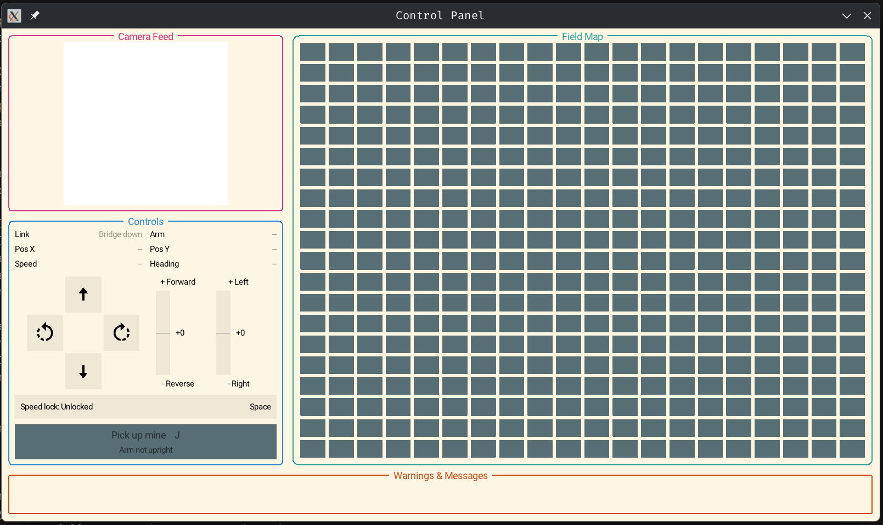
SOFTWARE
Control station GUI
1
Camera feed
Live RTSP video from the robot
2
Field map
Mines placed automatically as they are found
3
Drive controls
Arrow keys with smooth ramp; Space locks speed
4
Pick up mine (J)
Starts the autonomous pickup; disabled until the arm is upright
5
Link health
Stale data greyed out, never shown as zero
Minesweepers 13th Edition · Watad Ejust
24
Notes:
C++20 with Raylib for drawing and GStreamer for video. Layout and colours come from styles.toml, so they can be changed without recompiling.

Slide 25
OPERATION
Arena navigation plan
R
R
1
Start in a corner
Pose reset to the known corner before the first lane.
2
Lawnmower sweep
Parallel lanes, spacing = detector width minus overlap, so no strip of the field is missed.
3
Stop, signal, classify
Light and siren fire on every metal hit; surface mines are picked up on the spot.
4
Re-anchor at every corner
Each lane end near a corner resets drift.
5
Budget the 20 minutes
Sweep time ≈ (19 m / lane spacing) × 19 m / speed, planned to cover the whole field.
S
R
S start corner · R pose reset at a corner
Minesweepers 13th Edition · Watad Ejust
25
Notes:
Lane spacing and cruise speed come from field tests with the real detector.

Slide 26
SOFTWARE
Built to be reliable
1
One contract
2
Validate everything
A single versioned C++ header defines every message the GUI, bridge and vision process exchange.
Wrong size, version, flag, range or non-finite float: the message is dropped.
3
Dockerized robot stack
4
Tested
Host networking for DDS, devices found at boot, config bind-mounted so we can tune on site without rebuilding.
Unit and integration tests cover drive ramping, pickup gating, message decoding and the ZeroMQ link.
Minesweepers 13th Edition · Watad Ejust
26
Notes:
Telemetry arrives at 20 Hz; any source silent for 500 ms is marked stale.

Slide 27
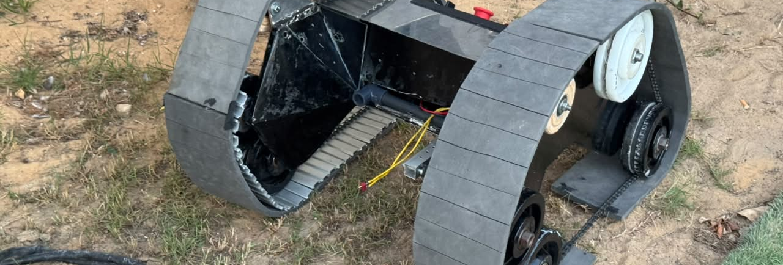
TEAM
Team, budget and next steps
Watad Ejust
Academia category
Mechanical · electronics · software
Budget-minded build
Wheelchair drive motors and a car wiper motor bought from the local market; an open-source software stack.
After the competition
Autonomous navigation: coverage planning on top of the existing localization
Onboard vision on a Jetson; the GUI protocol stays the same
Minesweepers 13th Edition · Watad Ejust
27
Notes:
Add team member names and the total spend if the jury asks.

Slide 28

Thank You

